Slide 1



Project Gaia
Enabling Climate Risks Analysis with Natural Language Processing
56th World Continuous Auditing and Reporting Symposium
Madrid, 27–28 April 2023
The expressed views are not necessarily the views of the BIS or Banco de España​

Slide 2

Index
Introduction
Quiz
Vision of GAIA
Technical Considerations

Slide 3

Need for climate related data
Dealing with climate change means managing climate-related risk
Physical
Transitional
Reliable data is vital for the Financial system

Slide 4

Challenges for climate data
Data gaps and limits to be addressed:
Traceability to the source
Greenwashing
Lack of standardization
Third party access rights

Slide 5
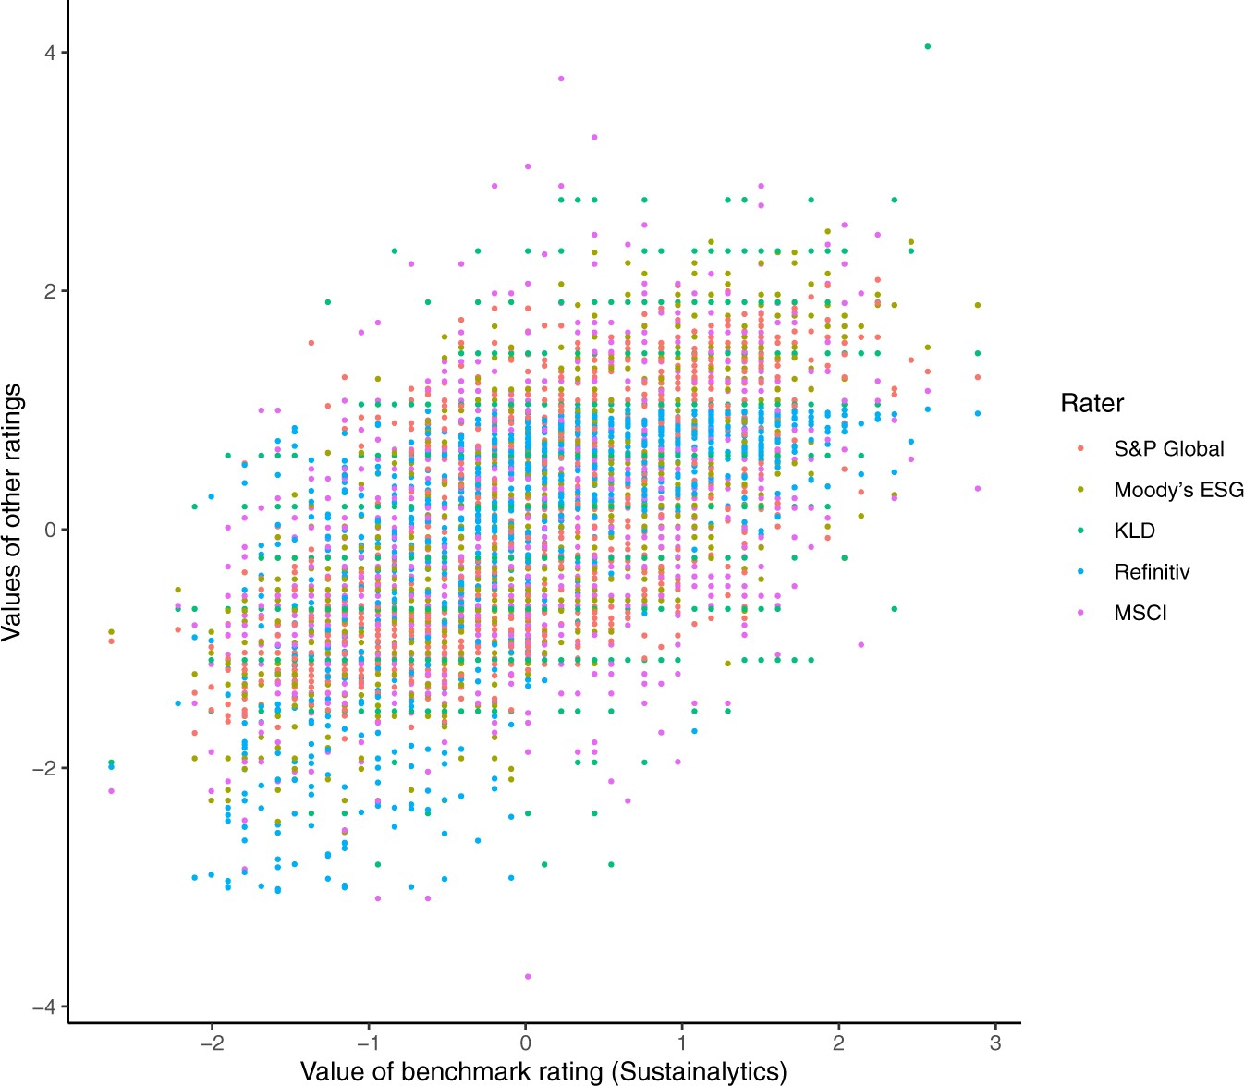
ESG Rating Divergence
Source: Berg et al. (2022)

Slide 6
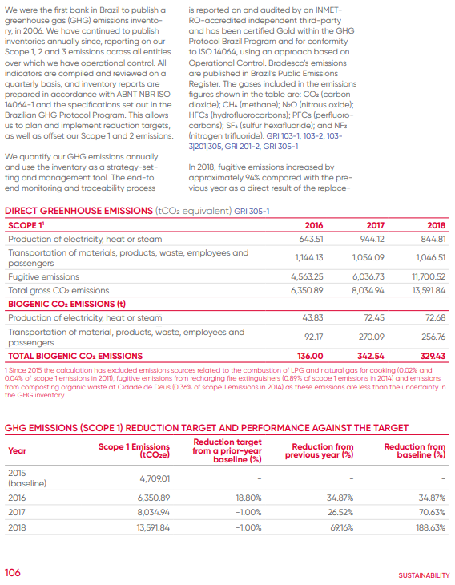

Analyzing ESG information
Notes:
CHANGE TO MENTI

Slide 7

Put yourself in the shoes of a climate risk analyst
Go to www.menti.com (enter code 89981516)

Slide 8
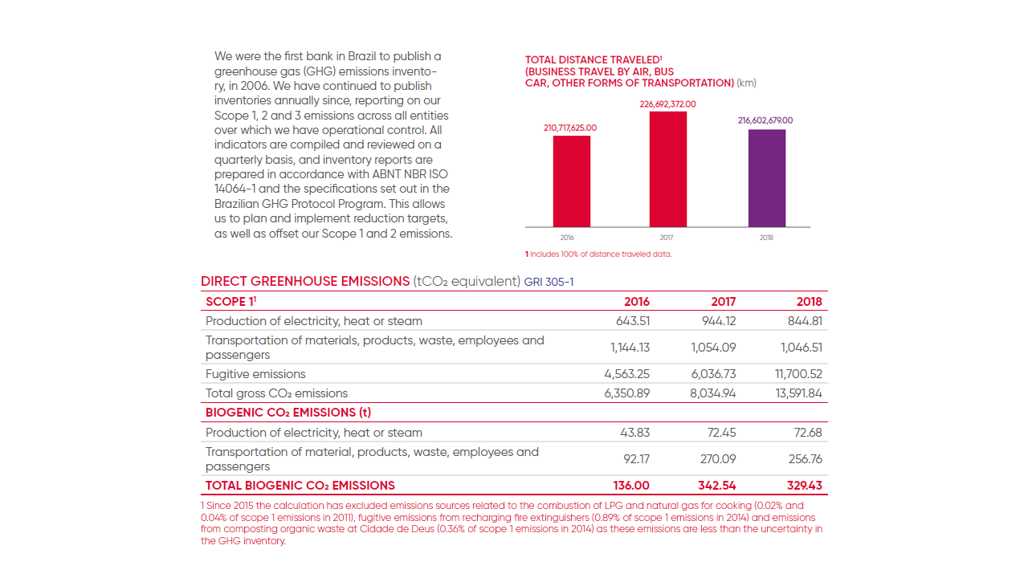

Question 1:
How much carbon dioxide was emitted in 2016?
www.menti.com 89981516

Slide 9

Question 2:
What standard was used for the inventory reports?
www.menti.com 89981516

Slide 10
Question 3:
How did the amount of business travel change from 2016 to 2018?
www.menti.com 89981516

Slide 11




Practical challenges faced as Climate Analyst
Time effort even for easy-to-find data
Format information is in tables, graphs, and inline in text
Context is explained in separate text or footnotes
Structure differs across firms and over the years

Slide 12

Project Gaia Vision
One platform to facilitate working with climate related reports.
  increase the usability of climate-related data
  reduce the manual effort during research
  build a reference for
  climate-related information

Slide 13






A View into the Engine Room
Publicly available corporate reports
Data
Processing
Output
PDF
NLP
Repository
Stored Reports
Text & Table extraction
Information extraction
Graphical User Interface

Slide 14




Many Ways to say the Same Thing
“In 2021, 96 percent of employees were included under the scope of the EMS”
“Merely 4 percent of employees were excluded from the EMS's purview in 2021”
“In 2021, the EMS encompassed nearly the entire workforce of 11400, with only 456”
“The EMS-scope coverage in 2021 excluded 4 out of 100 employees”

Slide 15

Large Language
Models:
The game changer?
Question 1:
How much carbon dioxide was emitted in 2016?
Chat GPT Response:
“The gross CO2 emissions were 6350,89 tCO2 equivalent”

Slide 16
Large Language
Models:
Good, but tuning required
Question 3:
How did the amount of business travel change from 2016 to 2018?
GPT Response:
“The table shows that the total distance traveled for business [...] was 210,717,625 km in 2016, 226,692,372 km in 2017, and 216,602,679 km in 2018. Therefore, the amount of business travel decreased by approximately 4.4% from 2017 to 2018.”

Slide 17
Project Gaia
Roadmap to a Proof of Concept
Based on work from Bank of Spain*
Design a User-centric front-end for facilitated data retrieval
Easy access of climate related data to all Central Banks
Research Large Language Models for green finance information extraction
Configure Enterprise-grade platform for report processing
*“ Analysis of ESG disclosures in Pillar 3 reports. A text mining approach” Ángel Iván Moreno Bernal y Teresa Caminero García (2022)

Slide 18

Project Gaia –
Enabling Climate
Risks Analysis
Join us

Slide 19
THANKS FOR YOUR ATTENTION
David.Kopfer@ecb.europa.eu
teresa.caminero@bde.es

